Slide 1
The Foundation of God’s Government
Revelation 12, 14
The Great Controversy Ch. 25, 26, 27
Lesson 9, 2nd Quarter 2024

Slide 2
Memory Text: And the dragon was wroth with the woman, and went to make war with the remnant of her seed, which keep the commandments of God, and have the testimony of Jesus Christ. Revelation 12:17
An overview of the Great Controversy in Revelation 12!

Slide 3
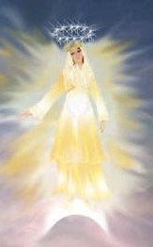
Revelation 12:1-17
12 And there appeared a great wonder in heaven; a woman clothed with the sun, and the moon under her feet, and upon her head a crown of twelve stars:
² And she being with child cried, travailing in birth, and pained to be delivered.

Slide 4
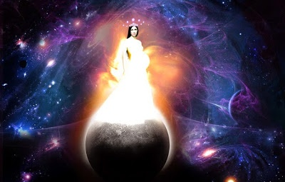
A Woman?
What Woman?
ISAIAH 54:5-6
⁵ For thy Maker is thine husband; the Lord of hosts is his name; and thy Redeemer the Holy One of Israel; The God of the whole earth shall he be called.
⁶ For the Lord hath called thee as a woman forsaken and grieved in spirit, and a wife of youth, when thou wast refused, saith thy God.
JEREMIAH 6:2
² I have likened the daughter of Zion to a comely and delicate woman.
And there appeared a great wonder in heaven; a woman clothed with the sun, and the moon under her feet, and upon her head a crown of twelve stars:

Slide 5
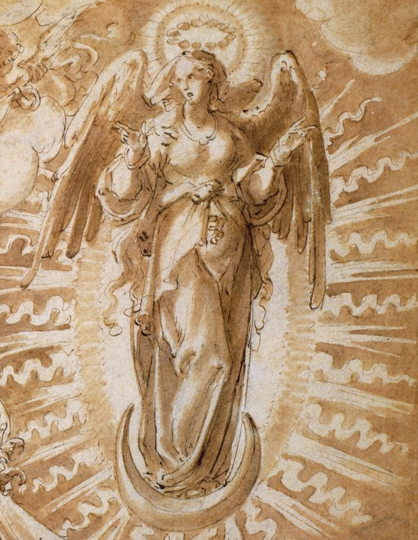
A Woman?
What Woman?
The Sun and the Moon
The “sun” may be thought of as representing the glory of God, especially as revealed in the gospel. The “moon” is understood by many commentators as representing the system of types and shadows of OT times, which were eclipsed by the greater revelation that came through Christ. The ceremonial law, being fulfilled in the life and death of Christ, could well be represented by the moon, which shines with light borrowed from the sun.
A crown of twelve stars:
Note that in Greek the word here translated “crown” is stephanos, a victor’s crown, and not diadema, a kingly (or in this case queenly) crown denoting royal authority.
And there appeared a great wonder in heaven; a woman clothed with the sun, and the moon under her feet, and upon her head a crown of twelve stars:

Slide 6
Isaiah 30:26
26 Moreover the light of the moon shall be as the light of the sun, and the light of the sun shall be sevenfold, as the light of seven days, in the day that the Lord bindeth up the breach of his people, and healeth the stroke of their wound.

Slide 7
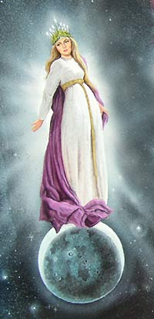
A Child?
What Child?
ISAIAH 7:14
¹⁴ Therefore the Lord himself shall give you a sign; Behold, a virgin shall conceive, and bear a son, and shall call his name Immanuel.
ISAIAH 26:17
¹⁷ Like as a woman with child, that draweth near the time of her delivery, is in pain, and crieth out in her pangs; so have we been in thy sight, O Lord.
And she being with child cried, travailing in birth, and pained to be delivered.

Slide 8
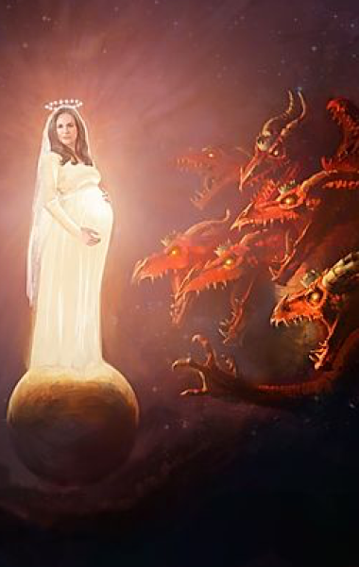
Revelation 12:3-17
³ And there appeared another wonder in heaven; and behold a great red dragon, having seven heads and ten horns, and seven crowns upon his heads.
⁴ And his tail drew the third part of the stars of heaven, and did cast them to the earth: and the dragon stood before the woman which was ready to be delivered, for to devour her child as soon as it was born.

Slide 9
Revelation 12:3-17
³ And there appeared another wonder in heaven; and behold a great red dragon, having seven heads and ten horns, and seven crowns upon his heads.
⁴ And his tail drew the third part of the stars of heaven, and did cast them to the earth: and the dragon stood before the woman which was ready to be delivered, for to devour her child as soon as it was born.
Obviously a power in opposition to Christ and His church on a mighty scale – Satan as we see in v. 9. The imagery recalls the “beast” powers of Daniel through which Satan has often worked.

Slide 10
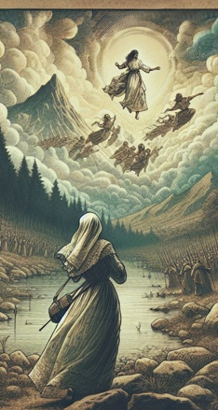
Revelation 12:5-17
⁵ And she brought forth a man child, who was to rule all nations with a rod of iron: and her child was caught up unto God, and to his throne.
⁶ And the woman fled into the wilderness, where she hath a place prepared of God, that they should feed her there a thousand two hundred and threescore days.

Slide 11
Revelation 12:5-17
⁵ And she brought forth a man child, who was to rule all nations with a rod of iron: and her child was caught up unto God, and to his throne.
⁶ And the woman fled into the wilderness, where she hath a place prepared of God, that they should feed her there a thousand two hundred and threescore days.
Clearly Jesus… But Jesus in His role as the Ascended King of Kings, not in His role as Servant or Sacrifice.

Slide 12
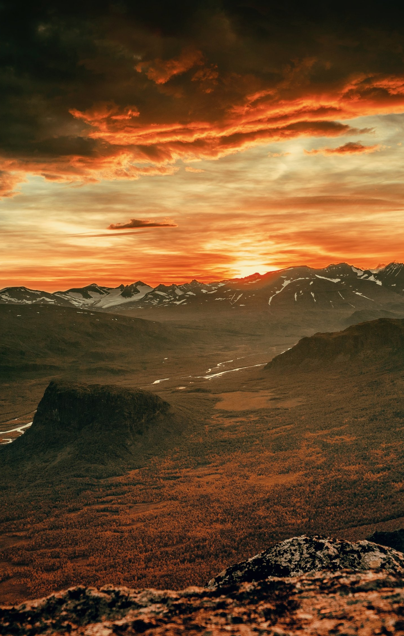
Revelation 12:5-17
⁵ And she brought forth a man child, who was to rule all nations with a rod of iron: and her child was caught up unto God, and to his throne.
⁶ And the woman fled into the wilderness, where she hath a place prepared of God, that they should feed her there a thousand two hundred and threescore days.

Slide 13
Revelation 12:5-17
Christ’s true church is protected in the “wilderness” after His ascension, and preserved there for 2300 years.
⁵ And she brought forth a man child, who was to rule all nations with a rod of iron: and her child was caught up unto God, and to his throne.
⁶ And the woman fled into the wilderness, where she hath a place prepared of God, that they should feed her there a thousand two hundred and threescore days.

Slide 14
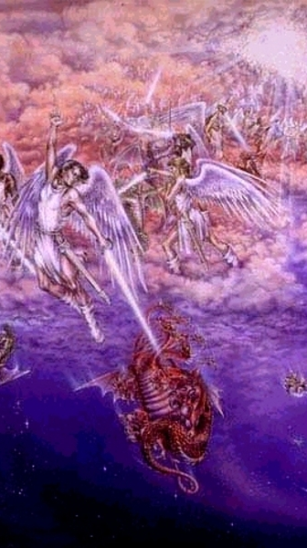
Revelation 12:7-17
⁷ And there was war in heaven: Michael and his angels fought against the dragon; and the dragon fought and his angels,
⁸ And prevailed not; neither was their place found any more in heaven.
⁹ And the great dragon was cast out, that old serpent, called the Devil, and Satan, which deceiveth the whole world: he was cast out into the earth, and his angels were cast out with him.

Slide 15
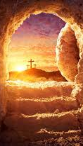
Revelation 12:10-17
¹⁰ And I heard a loud voice saying in heaven, Now is come salvation, and strength, and the kingdom of our God, and the power of his Christ: for the accuser of our brethren is cast down, which accused them before our God day and night.
¹¹ And they overcame him by the blood of the Lamb, and by the word of their testimony; and they loved not their lives unto the death.

Slide 16
Revelation 12:10-17
¹⁰ And I heard a loud voice saying in heaven, Now is come salvation, and strength, and the kingdom of our God, and the power of his Christ: for the accuser of our brethren is cast down, which accused them before our God day and night.
¹¹ And they overcame him by the blood of the Lamb, and by the word of their testimony; and they loved not their lives unto the death.
Satan and his angels were cast out of heaven in ages past (2 Peter 2:4), prior to the creation of this world. Nevertheless, it seems that until the cross he had access to heavenly beings, and to a limited extent, to the precincts of heaven. However this may be, a decisive casting out occurred at the cross, as our Lord Himself declared. That John here refers most particularly to events connected with Christ’s triumph on the cross is evident from the context.

Slide 17
Revelation 12:10-17
¹⁰ And I heard a loud voice saying in heaven, Now is come salvation, and strength, and the kingdom of our God, and the power of his Christ: for the accuser of our brethren is cast down, which accused them before our God day and night.
¹¹ And they overcame him by the blood of the Lamb, and by the word of their testimony; and they loved not their lives unto the death.
The first declaration by the “loud voice” consists of a series of facts relative to Christ’s triumph over Satan on the cross — the plan of “salvation” was made sure, “strength” was provided for resisting the wiles of Satan, Christ’s “kingdom” was made sure, and His “power,” literally, “authority,” to be man’s Saviour, high priest, and king was confirmed.

Slide 18
Revelation 12:10-17
¹⁰ And I heard a loud voice saying in heaven, Now is come salvation, and strength, and the kingdom of our God, and the power of his Christ: for the accuser of our brethren is cast down, which accused them before our God day and night.
¹¹ And they overcame him by the blood of the Lamb, and by the word of their testimony; and they loved not their lives unto the death.
The reason assigned in Rev. 12:10 for this fourfold achievement is specifically said to be that “the accuser of our brethren is cast down.” This clearly links these accomplishments with the casting down of v. 9.

Slide 19
Revelation 12:10-17
At the time of the casting down of vs. 9, 10, 13 “the accuser of our brethren” had already been actively accusing “them before our God day and night.” Obviously, the fall here referred to came after a period during which Satan had been accusing “the brethren,” and it would therefore appear that this cannot be the original casting out of Satan prior to the creation of our earth.
¹⁰ And I heard a loud voice saying in heaven, Now is come salvation, and strength, and the kingdom of our God, and the power of his Christ: for the accuser of our brethren is cast down, which accused them before our God day and night.
¹¹ And they overcame him by the blood of the Lamb, and by the word of their testimony; and they loved not their lives unto the death.

Slide 20
Revelation 12:10-17
Verse 11 specifically states that it was “the blood of the Lamb” — the death of Christ upon the cross — that had made victory over the “accuser of our brethren” possible.
¹⁰ And I heard a loud voice saying in heaven, Now is come salvation, and strength, and the kingdom of our God, and the power of his Christ: for the accuser of our brethren is cast down, which accused them before our God day and night.
¹¹ And they overcame him by the blood of the Lamb, and by the word of their testimony; and they loved not their lives unto the death.

Slide 21
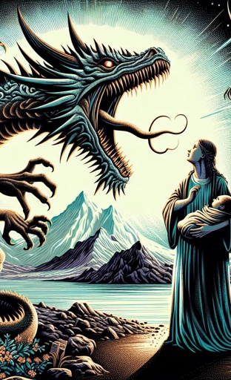
Revelation 12:12-17
¹² Therefore rejoice, ye heavens, and ye that dwell in them. Woe to the inhabiters of the earth and of the sea! for the devil is come down unto you, having great wrath, because he knoweth that he hath but a short time.
¹³ And when the dragon saw that he was cast unto the earth, he persecuted the woman which brought forth the man child.

Slide 22
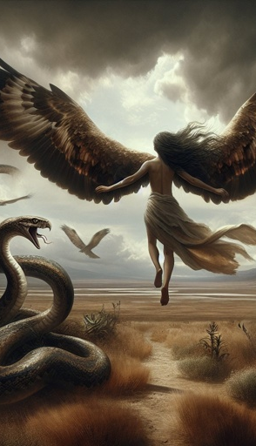
Revelation 12:14-17
¹⁴ And to the woman were given two wings of a great eagle, that she might fly into the wilderness, into her place, where she is nourished for a time, and times, and half a time, from the face of the serpent.
¹⁵ And the serpent cast out of his mouth water as a flood after the woman, that he might cause her to be carried away of the flood.
¹⁶ And the earth helped the woman, and the earth opened her mouth, and swallowed up the flood which the dragon cast out of his mouth.

Slide 23
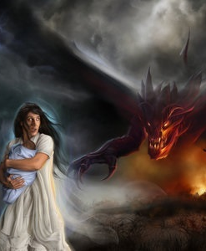
Revelation 12:17
¹⁷ And the dragon was wroth with the woman, and went to make war with the remnant of her seed, which keep the commandments of God, and have the testimony of Jesus Christ.

Slide 24
Revelation 12:17
That the remnant is thus identified indicates that the commandments of God will be especially controverted in this struggle between the dragon and church.
¹⁷ And the dragon was wroth with the woman, and went to make war with the remnant of her seed, which keep the commandments of God, and have the testimony of Jesus Christ.

Slide 25
The Seventh Trumpet
Revelation 11:15-19
¹⁵ And the seventh angel sounded; and there were great voices in heaven, saying, The kingdoms of this world are become the kingdoms of our Lord, and of his Christ; and he shall reign for ever and ever.
¹⁶ And the four and twenty elders, which sat before God on their seats, fell upon their faces, and worshipped God,
¹⁷ Saying, We give thee thanks, O Lord God Almighty, which art, and wast, and art to come; because thou hast taken to thee thy great power, and hast reigned.
This marks the beginning of the third woe and the end of the parenthesis between the sixth and seventh trumpets. Seventh-day Adventists date its beginning as 1844.

Slide 26
The Seventh Trumpet
Revelation 11:18-19
¹⁸ And the nations were angry, and thy wrath is come, and the time of the dead, that they should be judged, and that thou shouldest give reward unto thy servants the prophets, and to the saints, and them that fear thy name, small and great; and shouldest destroy them which destroy the earth.
¹⁹ And the temple of God was opened in heaven, and there was seen in his temple the ark of his testament: and there were lightnings, and voices, and thunderings, and an earthquake, and great hail.
There is opened before John a view of God’s heavenly temple, with “the ark of his testament” the focal point of the vision. Now, in the typical sanctuary, the ark was in the most holy place, which was the center of the service of the Day of Atonement — a typical day of judgment.

Slide 27
The Seventh Trumpet
Revelation 11:18-19
¹⁸ And the nations were angry, and thy wrath is come, and the time of the dead, that they should be judged, and that thou shouldest give reward unto thy servants the prophets, and to the saints, and them that fear thy name, small and great; and shouldest destroy them which destroy the earth.
¹⁹ And the temple of God was opened in heaven, and there was seen in his temple the ark of his testament: and there were lightnings, and voices, and thunderings, and an earthquake, and great hail.
It is in connection with the beginning of the seventh trumpet that John sees the temple in heaven and very particularly “the ark of his testament.” This indicates that the second and last division of Christ’s heavenly ministry, answering to the typical Day of Atonement, has opened.

Slide 28
The ark in the tabernacle on earth contained the two tables of stone, upon which were inscribed the precepts of the law of God. The ark was merely a receptacle for the tables of the law, and the presence of these divine precepts gave to it its value and sacredness.
The Great Controversy, p. 433

Slide 29
When the temple of God was opened in heaven, the ark of His testament was seen. Within the holy of holies, in the sanctuary in heaven, the divine law is sacredly enshrined—the law that was spoken by God Himself amid the thunders of Sinai and written with His own finger on the tables of stone.
The Great Controversy, p. 433

Slide 30
The law of God in the sanctuary in heaven is the great original, of which the precepts inscribed upon the tables of stone and recorded by Moses in the Pentateuch were an unerring transcript. Those who arrived at an understanding of this important point were thus led to see the sacred, unchanging character of the divine law.
The Great Controversy, p. 434

Slide 31
They saw, as never before, the force of the Saviour's words: “Till heaven and earth pass, one jot or one tittle shall in no wise pass from the law.” Matthew 5:18. The law of God, being a revelation of His will, a transcript of His character, must forever endure, “as a faithful witness in heaven.”
The Great Controversy, p. 434

Slide 32
Not one command has been annulled; not a jot or tittle has been changed. Says the psalmist: “Forever, O Lord, Thy word is settled in heaven.” “All His commandments are sure. They stand fast for ever and ever.” Psalm 119:89; 111:7, 8.
The Great Controversy, p. 434

Slide 33
In the very bosom of the Decalogue is the fourth commandment, as it was first proclaimed: “Remember the Sabbath day, to keep it holy. Six days shalt thou labor, and do all thy work: but the seventh day is the Sabbath of the Lord thy God…”
The Great Controversy, p. 434

Slide 34
Those who had accepted the light concerning the mediation of Christ and the perpetuity of the law of God found that these were the truths presented in Revelation 14. The messages of this chapter constitute a threefold warning which is to prepare the inhabitants of the earth for the Lord's second coming.
The Great Controversy, p. 435

Slide 35
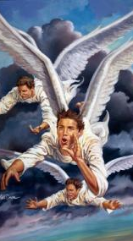
Revelation 14:6-12
⁶ And I saw another angel fly in the midst of heaven, having the everlasting gospel to preach unto them that dwell on the earth, and to every nation, and kindred, and tongue, and people,
⁷ Saying with a loud voice, Fear God, and give glory to him; for the hour of his judgment is come: and worship him that made heaven, and earth, and the sea, and the fountains of waters.

Slide 36
Revelation 14:6-12
The First Angel’s Message:
Worship our Creator God!
⁶ And I saw another angel fly in the midst of heaven, having the everlasting gospel to preach unto them that dwell on the earth, and to every nation, and kindred, and tongue, and people,
⁷ Saying with a loud voice, Fear God, and give glory to him; for the hour of his judgment is come: and worship him that made heaven, and earth, and the sea, and the fountains of waters.

Slide 37
Revelation 14:6-12
The word translated “fear” is the Greek phobed, “to fear,” “to reverence.” Phobed is used here not in the sense of being afraid of God, but in the sense of coming to Him with reverence and awe. It conveys the thought of absolute loyalty to God, of full surrender to His will.
⁶ And I saw another angel fly in the midst of heaven, having the everlasting gospel to preach unto them that dwell on the earth, and to every nation, and kindred, and tongue, and people,
⁷ Saying with a loud voice, Fear God, and give glory to him; for the hour of his judgment is come: and worship him that made heaven, and earth, and the sea, and the fountains of waters.

Slide 38
Revelation 14:6-12
The message to fear God is especially timely in the period represented by the preaching of this angel, for men are worshiping gods of materialism and pleasure and many others of their own and devising.
⁶ And I saw another angel fly in the midst of heaven, having the everlasting gospel to preach unto them that dwell on the earth, and to every nation, and kindred, and tongue, and people,
⁷ Saying with a loud voice, Fear God, and give glory to him; for the hour of his judgment is come: and worship him that made heaven, and earth, and the sea, and the fountains of waters.

Slide 39
Revelation 14:6-12
⁶ And I saw another angel fly in the midst of heaven, having the everlasting gospel to preach unto them that dwell on the earth, and to every nation, and kindred, and tongue, and people,
⁷ Saying with a loud voice, Fear God, and give glory to him; for the hour of his judgment is come: and worship him that made heaven, and earth, and the sea, and the fountains of waters.
Historically, the preaching of William Miller and his associates in the period from 1831 to 1844, concerning the close of the 2300 days in 1844, may be regarded as marking the beginning of the message of the first angel (see F. D. Nichol, The Midnight Cry, p. 284). But that message has had validity ever since and will continue to have until the curtain falls on man’s opportunity for salvation.

Slide 40
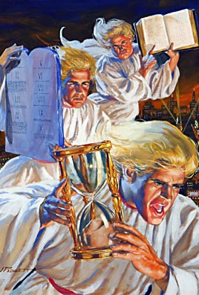
Revelation 14:8-12
⁸ And there followed another angel, saying, Babylon is fallen, is fallen, that great city, because she made all nations drink of the wine of the wrath of her fornication.

Slide 41
Revelation 14:8-12
⁸ And there followed another angel, saying, Babylon is fallen, is fallen, that great city, because she made all nations drink of the wine of the wrath of her fornication.
The ancient, literal city by this name was already largely a desolate ruin in John’s day. As with so many other terms and expressions in the Revelation, the significance of this name may best be understood in terms of the role of its historical counterpart in OT times.

Slide 42
The City of Babel
Babylon was founded by Nimrod. From the very beginning the city was emblematic of disbelief in the true God and defiance of His will, and its tower a monument to apostasy, a citadel of rebellion against Him.
Genesis 10:8-10
⁸ And Cush begat Nimrod: he began to be a mighty one in the earth.
⁹ He was a mighty hunter before the Lord: wherefore it is said, Even as Nimrod the mighty hunter before the Lord.
¹⁰ And the beginning of his kingdom was Babel, and Erech, and Accad, and Calneh, in the land of Shinar.
And there followed another angel, saying, Babylon is fallen, is fallen, that great city, because she made all nations drink of the wine of the wrath of her fornication.

Slide 43
The City of Babel
Babylon is Fallen:
By a play on words the Hebrew linked the name of the city, Babel, with the Hebrew verb balal, “to confuse.” It would have been a strange procedure, however, for the Babylonians to derive a name for their city from a Hebrew word. Ancient Babylonian texts interpret Bab-ilu or Bab-ilanu as meaning “port of god” or “gateway of the gods.” It is, however, possible that this meaning was secondary, and that the name was originally from the Babylonian verb babalu, meaning “to scatter,” or “to disappear.” Perhaps the Babylonians were not particularly proud of a name that reminded them of the inglorious climax of earlier plans for the city, and so invented an explanation that made itappear to be a compound of the names bab, “port,” and ilu, “god”.
And there followed another angel, saying, Babylon is fallen, is fallen, that great city, because she made all nations drink of the wine of the wrath of her fornication.

Slide 44
The City of Babel
The prophet Isaiah identifies Lucifer as the invisible king of Babylon. In fact, it would appear that Satan designed to make Babylon the center and agency of his master plan to secure control of the human race, even as God purposed to work through Jerusalem.
Isaiah 14:4, 12
⁴ That thou shalt take up this proverb against the king of Babylon, and say, How hath the oppressor ceased! the golden city ceased!
….
12 How art thou fallen from heaven, O Lucifer, son of the morning! how art thou cut down to the ground, which didst weaken the nations!
And there followed another angel, saying, Babylon is fallen, is fallen, that great city, because she made all nations drink of the wine of the wrath of her fornication.

Slide 45
The City of Babel
Thus, throughout OT times, the two cities typified the forces of evil and good at work in the world. The founders of Babylon aspired to set up a government entirely independent of God, and had He not intervened, they would eventually have succeeded in banishing righteousness from the earth. For this reason God saw fit to destroy the tower and to scatter its builders. A period of temporary success was followed by more than a millennium of decline and subjection to other nations.
And there followed another angel, saying, Babylon is fallen, is fallen, that great city, because she made all nations drink of the wine of the wrath of her fornication.

Slide 46
The City of Babel
When Nebuchadnezzar II rebuilt Babylon it became one of the wonders of the ancient world. His plan to make his kingdom universal and eternal was a success to the extent that, in splendor and power, the new Babylonian Empire surpassed its predecessors. However, it also became haughty and cruel. It conquered God’s people and threatened with defeat His purpose for them as a nation.
And there followed another angel, saying, Babylon is fallen, is fallen, that great city, because she made all nations drink of the wine of the wrath of her fornication.

Slide 47
The City of Babel
In a dramatic series of events God humbled Nebuchadnezzar and secured the submission of his will.
Daniel 5:18-21
¹⁸ O thou king, the most high God gave Nebuchadnezzar thy father a kingdom, and majesty, and glory, and honour:
¹⁹ And for the majesty that he gave him, all people, nations, and languages, trembled and feared before him: whom he would he slew; and whom he would he kept alive; and whom he would he set up; and whom he would he put down.
²⁰ But when his heart was lifted up, and his mind hardened in pride, he was deposed from his kingly throne, and they took his glory from him:
²¹ And he was driven from the sons of men; and his heart was made like the beasts, and his dwelling was with the wild asses: they fed him with grass like oxen, and his body was wet with the dew of heaven; till he knew that the most high God ruled in the kingdom of men, and that he appointeth over it whomsoever he will.
And there followed another angel, saying, Babylon is fallen, is fallen, that great city, because she made all nations drink of the wine of the wrath of her fornication.

Slide 48
The City of Babel
But his successors refused to humble themselves before God, and eventually the kingdom was weighed in the balances of heaven, found wanting, and its mandate revoked by the decree of the divine Watcher.
Daniel 5:22, 25-28
²² And thou his son, O Belshazzar, hast not humbled thine heart, though thou knewest all this; …
²⁵ And this is the writing that was written, Mene, Mene, Tekel, Upharsin.
²⁶ This is the interpretation of the thing: Mene; God hath numbered thy kingdom, and finished it.
²⁷ Tekel; Thou art weighed in the balances, and art found wanting.
²⁸ Peres; Thy kingdom is divided, and given to the Medes and Persians.
And there followed another angel, saying, Babylon is fallen, is fallen, that great city, because she made all nations drink of the wine of the wrath of her fornication.

Slide 49
The City of Babel
Later Babylon became one of the capitals of the Persian Empire, but it was partly destroyed by Xerxes. Over the centuries the city gradually lost more and more of its importance and eventually, toward the close of the 1st century A.D., virtually ceased to exist. Ever since the fall of ancient Babylon Satan has sought, through one world power after another, to control the world, and would probably long since have succeeded had it not been for repeated instances of divine intervention.
And there followed another angel, saying, Babylon is fallen, is fallen, that great city, because she made all nations drink of the wine of the wrath of her fornication.

Slide 50
The City of Babel
Babylon, both literal and mystical, has thus long been recognized as the traditional enemy of God’s truth and people. As used in the Revelation the name is symbolic of all apostate religious organizations and their leadership, from antiquity down to the close of time. A comparison of the many passages of the OT where the sins and fate of literal Babylon are set forth at length, with those in the Revelation descriptive of mystical Babylon, makes evident the appropriateness of the figurative application of the name. Babylon is a comprehensive term that John employs to describe all religious bodies and movements that have fallen away from the truth. This fact requires us to view this “fall” as progressive and cumulative.
And there followed another angel, saying, Babylon is fallen, is fallen, that great city, because she made all nations drink of the wine of the wrath of her fornication.

Slide 51
The City of Babel
This prophecy of the fall of Babylon finds its last-day fulfillment in the departure of Protestantism at large from the purity and simplicity of the gospel. This message was first preached by the advent movement known as Millerism, in the summer of 1844, and was applied to the churches that rejected the first angel’s message concerning the judgment. The message will have increasing relevance as the end draws near, and will meet its complete fulfillment with the union of the various religious elements under the leadership of Satan. The message of ch. 18:2-4 announces the complete downfall of Babylon and calls upon God’s people who are scattered throughout the various religious bodies comprising Babylon, to separate from them.
And there followed another angel, saying, Babylon is fallen, is fallen, that great city, because she made all nations drink of the wine of the wrath of her fornication.

Slide 52
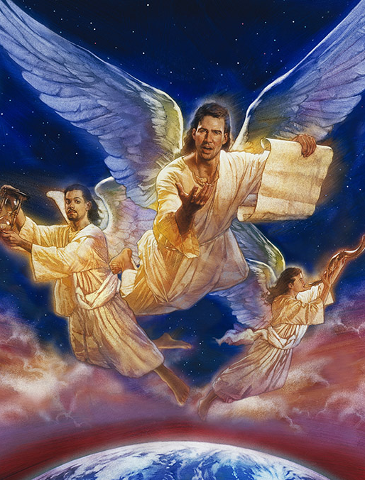
Revelation 14:9-12
⁹ And the third angel followed them, saying with a loud voice, If any man worship the beast and his image, and receive his mark in his forehead, or in his hand,
¹⁰ The same shall drink of the wine of the wrath of God, which is poured out without mixture into the cup of his indignation; and he shall be tormented with fire and brimstone in the presence of the holy angels, and in the presence of the Lamb:

Slide 53
Revelation 14:9-12
⁹ And the third angel followed them, saying with a loud voice, If any man worship the beast and his image, and receive his mark in his forehead, or in his hand,
¹⁰ The same shall drink of the wine of the wrath of God, which is poured out without mixture into the cup of his indignation; and he shall be tormented with fire and brimstone in the presence of the holy angels, and in the presence of the Lamb:
It should be noted that this warning will have ultimate force only after the healing of the deadly wound, and the formation of the image to the beast, when the mark of the beast becomes an issue. As preached today, the third angel’s message is a warning concerning issues to come, a warning that will enlighten men as to the issues involved in the developing struggle and enable them to make an intelligent choice.

Slide 54
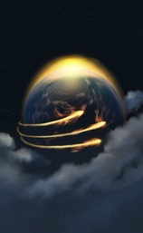
Revelation 14:11-12
¹¹ And the smoke of their torment ascendeth up for ever and ever: and they have no rest day nor night, who worship the beast and his image, and whosoever receiveth the mark of his name.
¹² Here is the patience of the saints: here are they that keep the commandments of God, and the faith of Jesus.

Slide 55
Revelation 14:11-12
¹¹ And the smoke of their torment ascendeth up for ever and ever: and they have no rest day nor night, who worship the beast and his image, and whosoever receiveth the mark of his name.
¹² Here is the patience of the saints: here are they that keep the commandments of God, and the faith of Jesus.
The third angel utters a most fearful threat. The inhabitants of earth will be without excuse if they do not escape the entanglement here warned against. They should put forth every effort to discover the identity of the beast, his image, and mark, and to become acquainted with his wiles and policies.

Slide 56
Revelation 14:11-12
This statement is particularly significant in its context. Led captive by Satan’s delusions, the world will bow to the beast and its image, and carry out its dictates and decrees. The saints, on the other hand, refuse to comply with its demands. They keep the commandments of God. The special point controverted will be the fourth of the Ten Commandments.
¹¹ And the smoke of their torment ascendeth up for ever and ever: and they have no rest day nor night, who worship the beast and his image, and whosoever receiveth the mark of his name.
¹² Here is the patience of the saints: here are they that keep the commandments of God, and the faith of Jesus.

Slide 57
The Commandments of God
There is general agreement among Christians that the other nine are of universal obligation, but early in the Christian Era men began to set aside the seventh-day Sabbath and to substitute the observance of the first day of the week as the day of worship. Sunday-observing Christians today set forth various reasons as to why they observe the first day of the week instead of the seventh, and as to why they feel free to ignore the original Sabbath. Some say that the Decalogue was abolished along with all OT laws; others that the time element in the fourth commandment is ceremonial but the observance of one day every seven is a moral obligation. In the Roman Church the claim was long made that the church had, by its divine authority, transferred the sacredness of the day.
Here is the patience of the saints: here are they that keep the commandments of God, and the faith of Jesus.

Slide 58
The Commandments of God
However, in recent decades attempts have been made to invoke the authority of Christ and the apostles. Since all those views are unsupported by Scripture, they are unacceptable to all for whom the Bible and the Bible only is the rule of faith. The crisis will come when symbolic Babylon prevails upon the state to enforce Sunday observance by civil law and seeks to punish all dissenters. In this dark hour those who cling to the Bible will refuse to give up the observance of the true Sabbath. Among the identifying features of the faithful ones that might have been mentioned, the prophecy points out two predominant marks: the keeping of the commandments of God and of the faith of Jesus.
Here is the patience of the saints: here are they that keep the commandments of God, and the faith of Jesus.

Slide 59
In the issue of the contest all Christendom will be divided into two great classes—those who keep the commandments of God and the faith of Jesus, and those who worship the beast and his image and receive his mark.
The Great Controversy, p. 450

Slide 60
Although church and state will unite their power to compel “all, both small and great, rich and poor, free and bond” (Revelation 13:16), to receive “the mark of the beast,” yet the people of God will not receive it.
The Great Controversy, p. 450

Slide 61
The prophet of Patmos beholds “them that had gotten the victory over the beast, and over his image, and over his mark, and over the number of his name, stand on the sea of glass, having the harps of God” and singing the song of Moses and the Lamb.
Revelation 15:2, 3.
The Great Controversy, p. 450

Slide 62
Now as in former ages, the presentation of a truth that reproves the sins and errors of the times will excite opposition. “Everyone that doeth evil hateth the light, neither cometh to the light, lest his deeds should be reproved.” John 3:20.
The Great Controversy, p. 458

Slide 63
As men see that they cannot maintain their position by the Scriptures, many determine to maintain it at all hazards, and with a malicious spirit they assail the character and motives of those who stand in defense of unpopular truth. It is the same policy which has been pursued in all ages.
The Great Controversy, p. 458

Slide 64
Elijah was declared to be a troubler in Israel, Jeremiah a traitor, Paul a polluter of the temple. From that day to this, those who would be loyal to truth have been denounced as seditious, heretical, or schismatic.
The Great Controversy, p. 458

Slide 65
Multitudes who are too unbelieving to accept the sure word of prophecy will receive with unquestioning credulity an accusation against those who dare to reprove fashionable sins. This spirit will increase more and more.
The Great Controversy, p. 458

Slide 66
And the Bible plainly teaches that a time is approaching when the laws of the state will so conflict with the law of God that whosoever would obey all the divine precepts must brave reproach and punishment as an evildoer.
The Great Controversy, p. 458

Slide 67
In view of this, what is the duty of the messenger of truth? Shall he conclude that the truth ought not to be presented, since often its only effect is to arouse men to evade or resist its claims? No; he has no more reason for withholding the testimony of God's word, because it excites opposition, than had earlier Reformers.
The Great Controversy, p. 459

Slide 68
The confession of faith made by saints and martyrs was recorded for the benefit of succeeding generations. Those living examples of holiness and steadfast integrity have come down to inspire courage in those who are now called to stand as witnesses for God.
The Great Controversy, p. 459

Slide 69
They received grace and truth, not for themselves alone, but that, through them, the knowledge of God might enlighten the earth. Has God given light to His servants in this generation? Then they should let it shine forth to the world.
The Great Controversy, p. 459

Slide 70
Anciently the Lord declared to one who spoke in His name: “The house of Israel will not hearken unto thee; for they will not hearken unto Me.” Nevertheless He said: “Thou shalt speak My words unto them, whether they will hear, or whether they will forbear.” Ezekiel 3:7; 2:7.
The Great Controversy, p. 459

Slide 71
To the servant of God at this time is the command addressed: “Lift up thy voice like a trumpet, and show My people their transgression, and the house of Jacob their sins.”
The Great Controversy, p. 459

Slide 72
The great obstacle both to the acceptance and to the promulgation of truth is the fact that it involves inconvenience and reproach. This is the only argument against the truth which its advocates have never been able to refute. But this does not deter the true followers of Christ.
The Great Controversy, p. 460

Slide 73
These do not wait for truth to become popular. Being convinced of their duty, they deliberately accept the cross, with the apostle Paul counting that “our light affliction, which is but for a moment,
The Great Controversy, p. 460

Slide 74
worketh for us a far more exceeding and eternal weight of glory;” with one of old, “esteeming the reproach of Christ greater riches than the treasures in Egypt.” 2 Corinthians 4:17; Hebrews 11:26.
The Great Controversy, p. 460

Slide 75
Whatever may be their profession, it is only those who are world servers at heart that act from policy rather than principle in religious things. We should choose the right because it is right, and leave consequences with God.
The Great Controversy, p. 460

Slide 76
To men of principle, faith, and daring, the world is indebted for its great reforms. By such men the work of reform for this time must be carried forward.
The Great Controversy, p. 460

Slide 77
Thus saith the Lord: “Hearken unto Me, ye that know righteousness, the people in whose heart is My law; fear ye not the reproach of men, neither be ye afraid of their revilings.
The Great Controversy, p. 460

Slide 78
For the moth shall eat them up like a garment, and the worm shall eat them like wool: but My righteousness shall be forever, and My salvation from generation to generation.” Isaiah 51:7, 8.
The Great Controversy, p. 460

Slide 79
Thank You!
Happy Sabbath!!

